Slide 1
Flow Networks
Lecture Delivered by:
Dr. A.Kannan, SCOPE, VIT, Vellore-632014.
Coverage:
- Flow Networks Concepts
- Multiple Sources and Sinks
- Max-Flow and Min-cut
- Ford-Fulkerson Method
- Edmonds-Karp algorithm
- Maximum bipartite matching

Slide 2
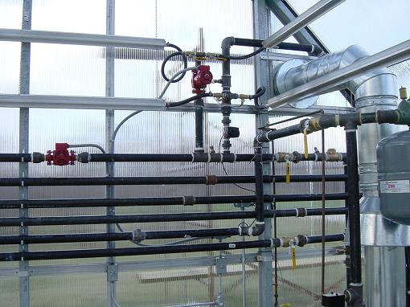
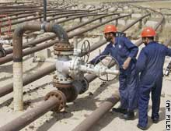
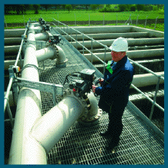
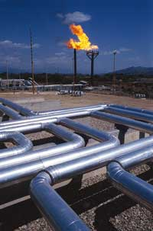
Network Flow

Slide 3
Flow Networks
General Characteristics
  Source : Materials are produced at a steady rate.
  Sink : Materials are consumed at the same rate.
  Flows through conduits (channel for flow) are constrained to max values.
Applications
  Liquid flow through pipes.
  Current flow through a circuit.
  Information in a communications network.

Slide 4
Types of Networks
Internet
Telephone
Cell
Highways
Rail
Electrical Power
Water
Sewer
Gas
…

Slide 5
Flow networks:
A flow network G=(V,E): a directed graph, where each edge (u,v)∈E has a nonnegative capacity c(u,v)>=0.
If (u,v)∉E, we assume that c(u,v)=0.
Two distinct vertices :a source s and a sink t.
12
16
20
s
10
9
7
t
4
13
4
14

Slide 6
Flow Network
3
1
3
2
1
2
1
0
3
5
1
Oil
Field
1
3
1
3
Refinery
1
1
2
4
Pipelines
and Valves
Maximize flow subject to capacity
and conservation of flow.
Is this OK?

Slide 7
Maximum flow problem
Maximum flow problem:
What is the greatest flow of materials from source to sink that does not violate any capacity constraints?
- Flow must be less than the capacity.
- At each node, the total incoming flow must be equal to the total outgoing flow.
- There is no incoming flow at the source
- There is no outgoing flow from the sink. (Terminal node)

Slide 8
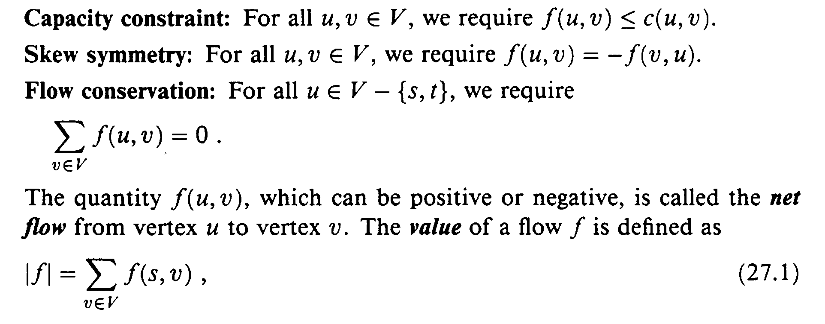
Flow Networks
G = (V,E) is a directed graph
  Edge (u,v) ∋ E has capacity c(u,v) ≥ 0
  wo distinct vertices: source s and sink t
The flow f : V x V → R satisfies the following:
  There is no net flow between vertices u and v if there is no edge between them

Slide 9
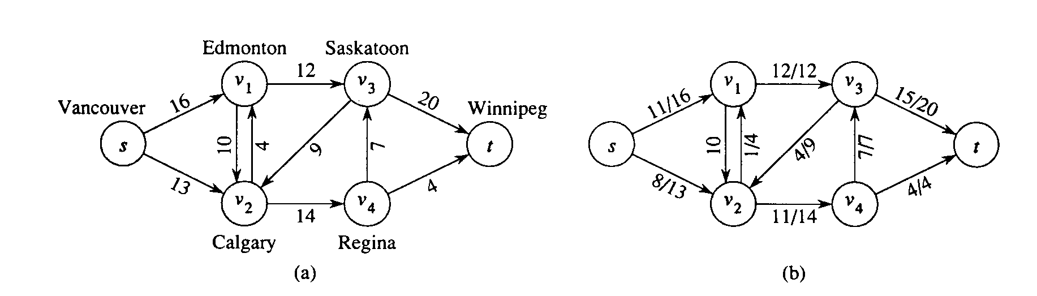
Example of a Flow Network
(a) Shows the maximum shipping capacities from the source Vancouver to the sink Winnipeg
in (b) the |f| = 19 and only possible flow is shown
It turns out 19 is not the maximal flow; experiment with this network on the next page and try to find the maximal flow.

Slide 10
Max Flow and Min Cut
1.Route : s->v1->v3->t : 12
Max flows at s->v1 and V3->t are 16 and 20 respectively.
Max flow at v1->v3 is 12.
Min-cut: 12 is the minimum and hence 12 is chosen.
2. s->v3->v4->t : 4
3. s->v1>v2->v4->v3->t = 7
Total = 23.
The max flow is = 23.

Slide 11
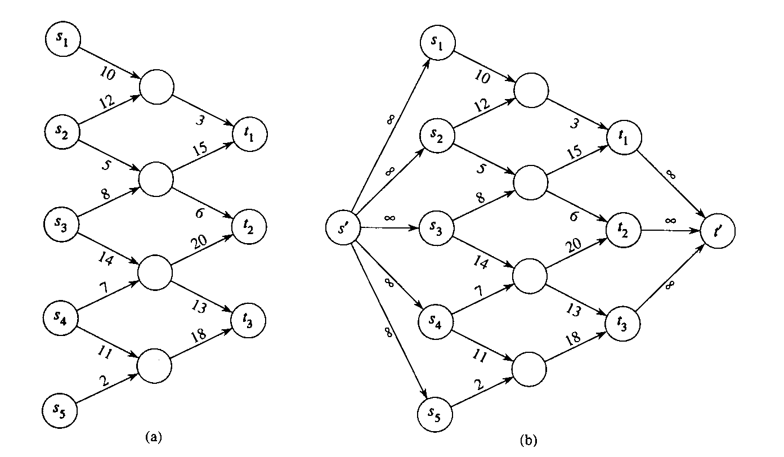
Multiple Sources and Sinks
Problems with multiple sources and sinks can be reduced to the single source/sink case
A supersource with ∞ outgoing capacities to the multiple sources is added
A super sink with ∞ incoming capacities from the multiple sinks is added.

Slide 12
The Ford-Fulkerson method:
This section presents the Ford-Fulkerson method for solving the maximum-flow problem.
We call it a “method” rather than an “algorithm” because it encompasses several implementations with different running times.

Slide 13
Ford-Fulkerson method Contd..
The Ford-Fulkerson method depends on three important ideas that transcend the method and are relevant to many flow algorithms and problems: residual networks, augmenting paths, and cuts.
These ideas are essential to the important max-flow min-cut theorem, which characterizes the value of maximum flow in terms of cuts of the flow network.

Slide 14
The Ford-Fulkerson Method
New Ideas
  Residual flow networks - These show where extra capacity might be found (remaining capacity).
  Augmenting paths - The path along which extra capacity is possible.
  Cuts - Used to characterize the maximum flow possible in a network.

Slide 15
Residual networks:
Given a flow network and a flow, the residual network consists of edges that can admit more net flow.
G=(V,E) --a flow network with source s and sink t
f: a flow in G.
The amount of additional net flow from u to v before exceeding the capacity c(u,v) is the residual capacity of (u,v), given by: c_{f}(u,v)=c(u,v)-f(u,v)
in the other direction: c_{f}(v, u)=c(v, u)+f(u, v).

Slide 16
Example of residual network
12
4/12
v₁
v₃
v₁
v₃
16
20
4/16
20
s
10
4
7
t
s
7
9
10
4
t
4/9
13
4
13
4/4
v₂
v₄
v₂
v₄
14
4/14
(a)

Slide 17
Example of Residual network (continued)
8
12
v₁
v₃
20
4
s
4
4
10
4
t
7
5
13
10
4
v₂
v₄
4
(b)

Slide 18
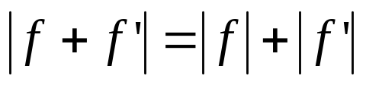
Fact 1:
Let G=(V,E) be a flow network with source s and sink t, and let f be a flow in G.
Let G_{f} be the residual network of G induced by f,and let f’ be a flow in G_{f}.Then, the flow sum f+f’ is a flow in G with value .
f+f’: the flow in the same direction will be added.
the flow in different directions will be cancelled.

Slide 19
Augmenting paths:
Given a flow network G=(V,E) and a flow f, an augmenting path is a simple path from s to t in the residual network G_{f}.
Residual capacity of p : the maximum amount of net flow that we can ship along the edges of an augmenting path p, i.e., c_{f}(p)=min{c_{f}(u,v):(u,v) is on p}.
2
3
1
The residual capacity is 1.

Slide 20
Example of an augment path (bold edges)
8
12
v₁
v₃
20
4
s
4
4
10
4
t
7
5
13
10
4
v₂
v₄
4
(b)

Slide 21
Ford-Fulkerson Method Simplified
FORD-FULKERSON-METHOD(G,s,t)
initialize flow f to 0
while there exists an augmenting path p
do augment flow f along p
return f

Slide 22

The basic Ford-Fulkerson algorithm:
FORD-FULKERSON(G,s,t)
for each edge (u,v) ∈E[G]
do f[u,v] 0
f[v,u] 0
while there exists a path p from s to t in the residual network G_{f}
do c_{f}(p) min{c_{f}(u,v): (u,v) is in p}
for each edge (u,v) in p
do f[u,v] f[u,v]+c_{f}(p)

Slide 23
Example:
The execution of the basic Ford-Fulkerson algorithm.
(a)-(d) Successive iterations of the while loop: The left side of each part shows the residual network G_{f} from line 4 with a shaded augmenting path p.
The right side of each part shows the new flow f that results from adding f_{p} to f.
The residual network in (a) is the input network G.(e) The residual network at the last while loop test.
It has no augmenting paths, and the flow f shown in (d) is therefore a maximum flow.

Slide 24
12
4/12
v₁
v₃
v₁
v₃
16
20
4/16
20
s
10
4
7
t
s
7
9
10
4
t
4/9
13
4
13
4/4
v₂
v₄
v₂
v₄
14
4/14
(a)

Slide 25
8
12
4/12
v₁
v₃
v₁
v₃
20
7/20
4
11/16
s
4
4
10
4
t
s
4
7/7
t
7
7/10
4/9
5
13
10
4
13
4/4
v₂
v₄
v₂
v₄
4
11/14
(b)

Slide 26
8
12/12
5
v₁
v₃
13
v₁
v₃
4
11/16
15/20
11
4
s
3
11
7
7
t
s
7/7
10
1/4
t
5
4/9
13
3
8/13
4/4
v₂
v₄
4
v₂
v₄
11
11/14
(c)

Slide 27
12
12/12
5
v₁
v₃
5
v₁
v₃
11/16
19/20
11
4
s
7
15
t
s
5
11
3
10
1/4
7/7
t
5
9
8
3
12/13
4/4
v₂
v₄
4
v₂
v₄
11
11/14
(d)

Slide 28
Relationships Between Flows
Let G_{f} be a residual graph induced by flow f
  consider a flow f’ in the residual graph
  the sum of the flows |f| + |f’| is a new flow |f + f’| in the original graph

Slide 29
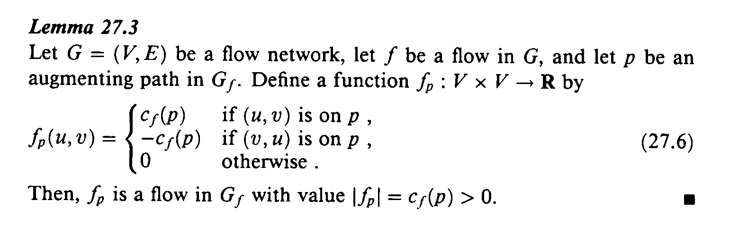
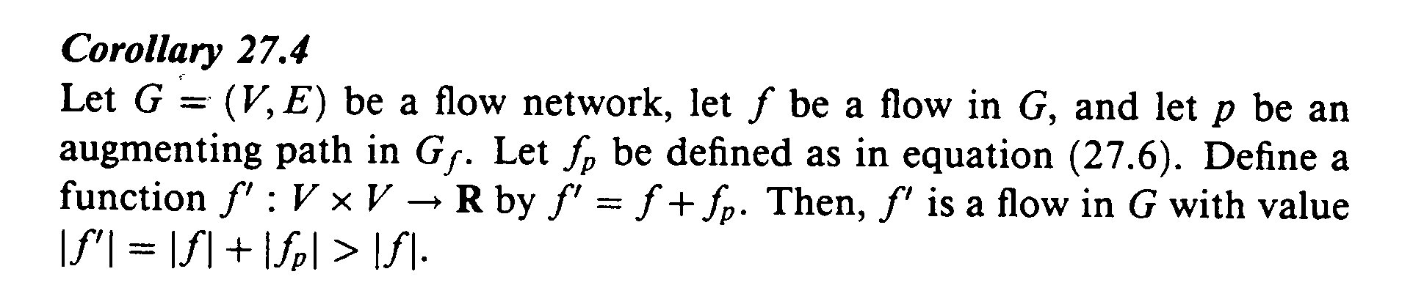
Augmenting Paths
An augmenting path is a simple path from s to t in the residual network
  The residual capacity of the augmenting path p is the maximum additional flow we can allow along the augmenting path
  c_{f} (p) = min {c_{f} (u,v) : (u,v) is on p }

Slide 30
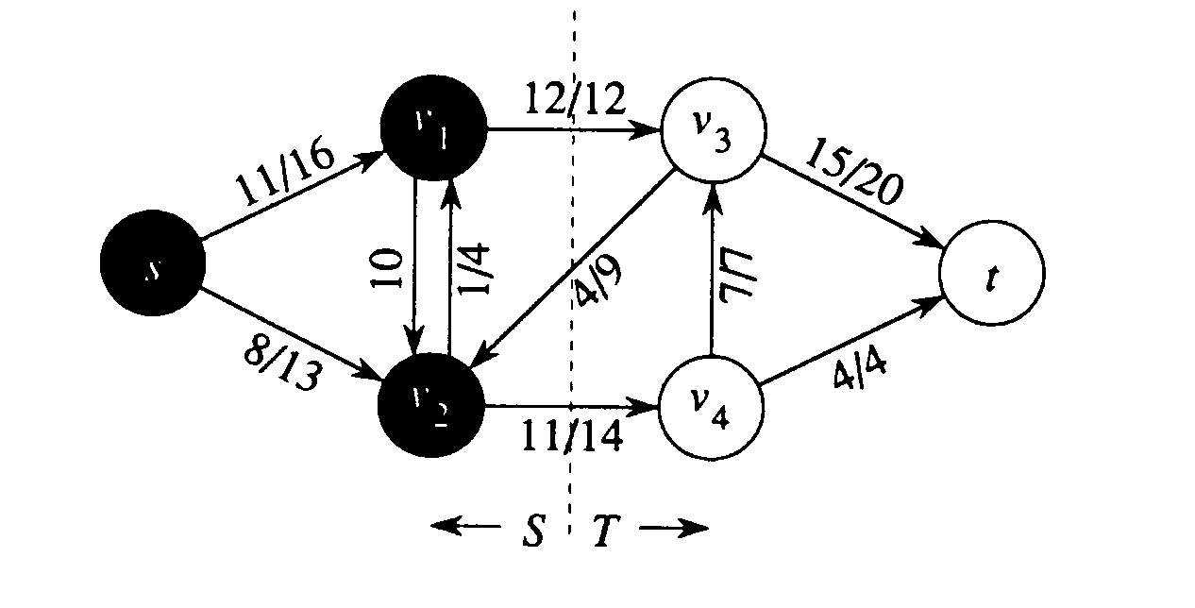
Cuts of Flow Networks
Definitions
  a cut(S,T) of flow network G=(V,E) is a partition of V into S and T= V - S such that s ∈ S and t ∈ T
  the net flow across a cut is f(S,T), the capacity is c(S,T)
  f(S,T)=f(v1,v3)+f(v2,v3)+f(v2,v4)=12+(-4)+11=19
  c(S,T) = c(v1,v3) + c(v2+v4) = 12 + 14 = 26

Slide 31
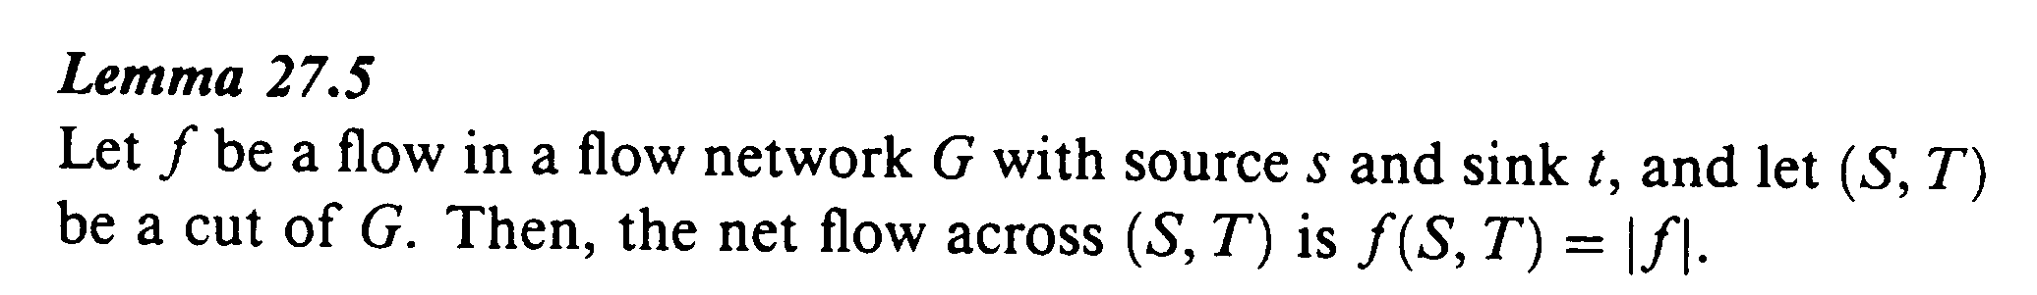
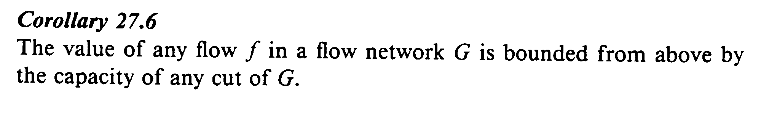
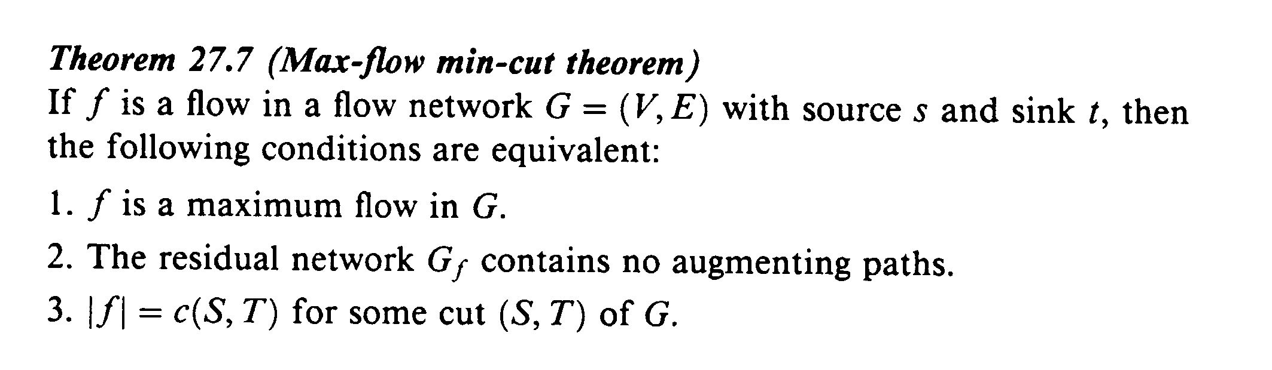
Max-flow, min-cut Theorem

Slide 32
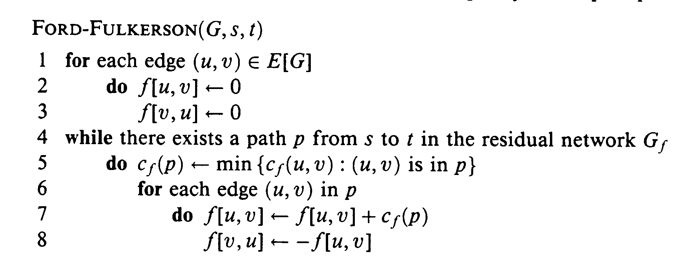
Complexity - Ford-Fulkerson Method
Complxity Analysis
  lines 1-3 take Θ(E) time
  lines 4-8 take at most |f*| time since the flow value has to increase by 1 (for integer values) each time
  this may be acceptable in most cases but not all, as we will see shortly

Slide 33
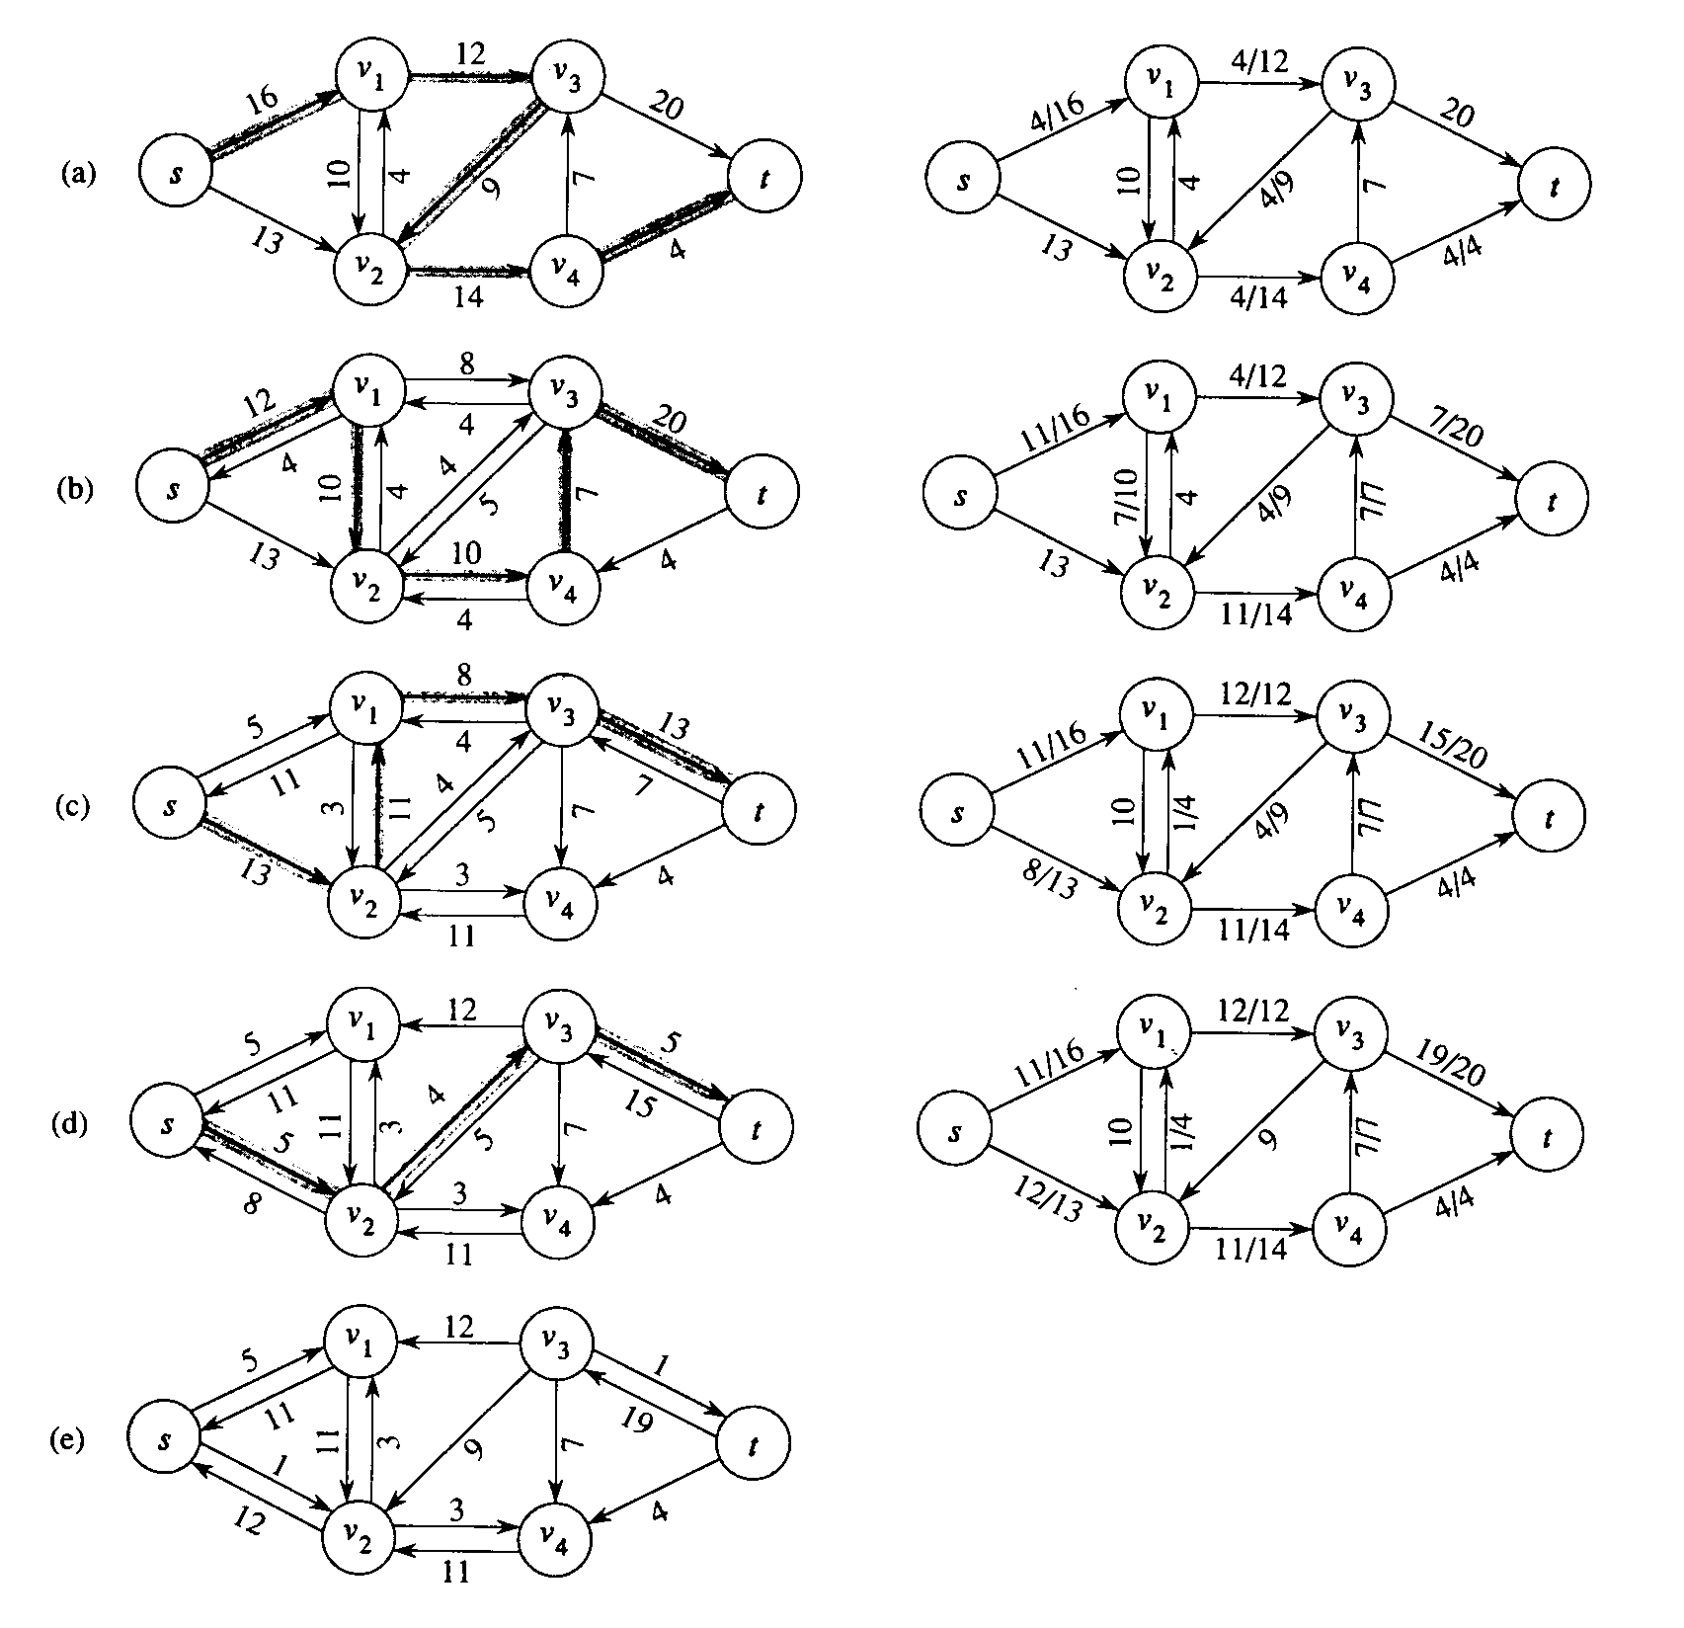
EXAMPLE
EXECUTION
to the left are successive iterations of the while loop
to the right are the residual graphs
the final solution is shown in (d)

Slide 34
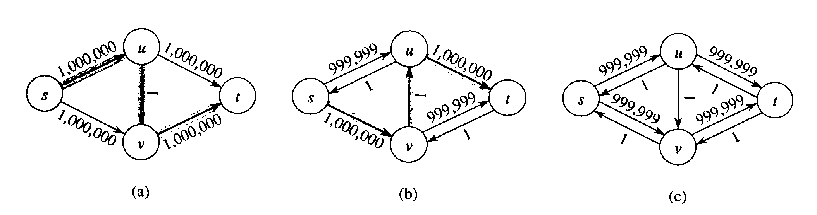
Avoiding Worst Case Behavior
The behavior shown above should be avoided:
  The maximum flow is 2,000,000; if the path with 1 is selected, there are 2,000,000 augmentations.
Edmonds-Karp algorithm
  Uses a breadth-first search to find the shortest path from s to t in the residual network.
  The total time complexity even for irrational flow is O( V E² ).

Slide 35
Edmonds-Karp algorithm
Edmonds–Karp algorithm is an implementation of the Ford–Fulkerson method for computing the maximum flow in a flow network in O(∣V∣⋅∣E∣2). Time by using Breadth First Search Algorithm.
Edmonds-Karp improved the runtime of Ford-Fulkerson, which is O(∣E∣⋅f∗), to O(∣V∣⋅∣E∣2).
This improvement is important because it makes the runtime of Edmonds-Karp independent of the maximum flow of the network, f∗.

Slide 36
Edmonds-Karp Algorithm
The augmenting path is a shortest path from s to t in the residual graph.
Here, the number of edges are counted for the shortest path.

Slide 37
SEARCH ALGORITHMS
Depth First Search
Breadth First Search
Applications of Breadth First Search
Single Source Shortest Path
Graph Matching

Slide 38
Edmonds-Karp Algorithm-Simplified
maximum_flow = 0;
residual_graph = network_graph;
while residual_graph contains an s − t path P do:
Let P be an s − t path in residual_graph with the minimum number of edges.
Augment maximum_flow using P.
Update residual_graph;
end while
return maximum_flow;

Slide 39
Distribution Problems
Merchandise distribution
  Sources with production rates
  Sinks with consumption rates
  Distribution centers
    Input rate = output rate
  Channels with maximum rate and unit cost for distribution

Slide 40
Merchandise distribution
0
Factories
0
1
1
2
2
2
7
3
3
3
4
4
4
Distribution
Centers
5
5
5
6
6
6
Retail
Locations
7
7
7
8
8
8
9
9
9
Get product to retail locations cheaply

Slide 41
Transportation Problems
Communications
  Max total data rate between a source and sink
  Cheapest way to move a given amount of data from s to t
Traffic flow
  Minimize evacuation time
  Minimize total cost

Slide 42
Matching Problems
Job placement
  Interviews + job offers
  Maximize number of placements
Min-distance point matching
  Two sets A and B of N points each
  Find set of N segments matching an element from A with one from B that has lowest cost

Slide 43
Matching Problems
Job placement
  Interviews + job offers
  Maximize number of placements
Min-distance point matching
  Two sets A and B of N points each
  Find set of N segments matching an element from A with one from B that has lowest cost

Slide 44
Matching Problem
0
0
1
1
2
2
2
3
3
3
4
4
7
4
Employer
Offers
5
Applicant
5
5
6
6
6
7
7
7
8
8
8
9
9
9
Maximize placements (matching)

Slide 45
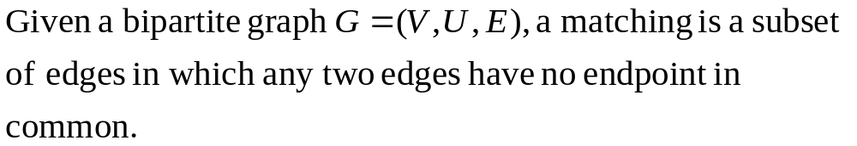
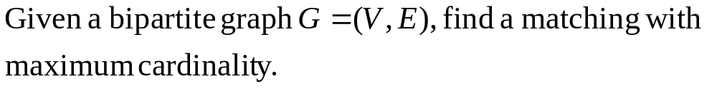
Matching in Bipartite Graph
Maximum Matching

Slide 46
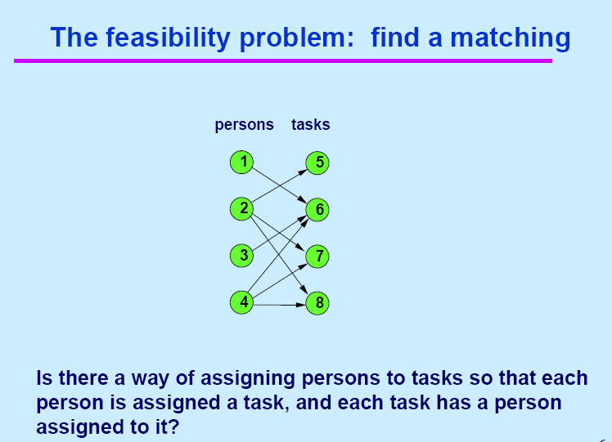

Slide 47
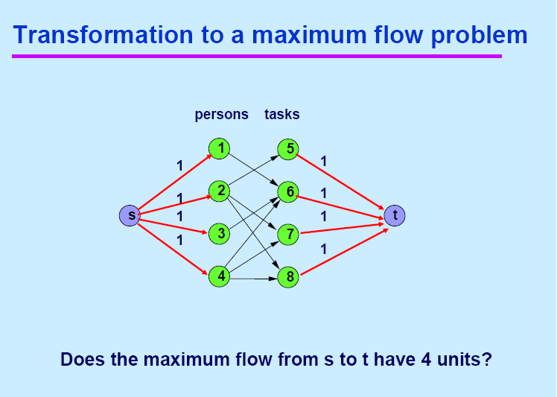
1
1

Slide 48
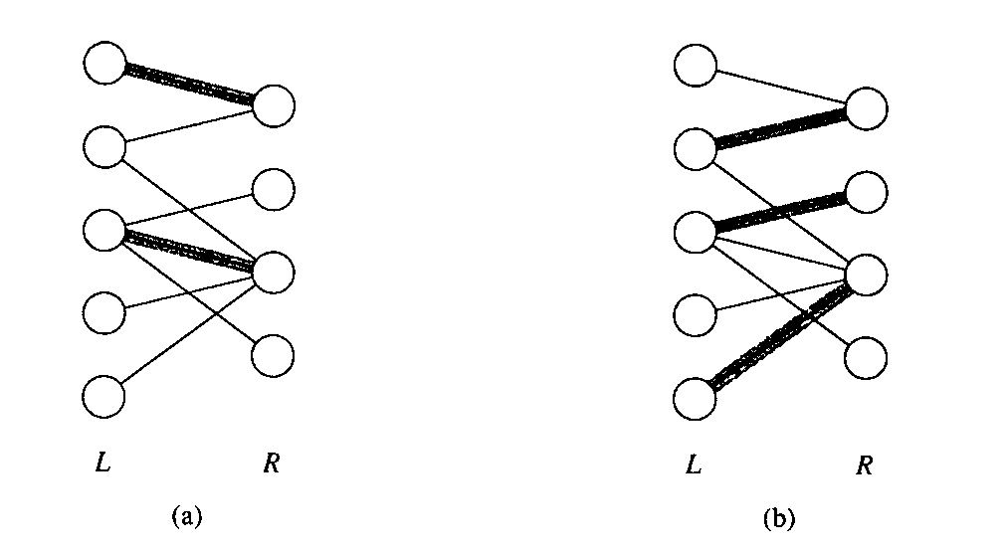
Maximum Bipartite Matching
A Sample Problem
  a bipartitle graph has two disjoint subsets of nodes
  what is the maximum possible matching?
An Application
  let L be a set of machines and R a set of tasks
  an edge means that a particular machine can perform a particular task
  the maximal matching provides work for as many machines as possible in parallel.

Slide 49
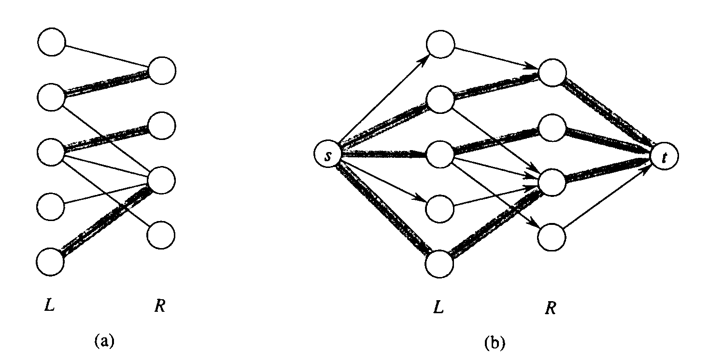
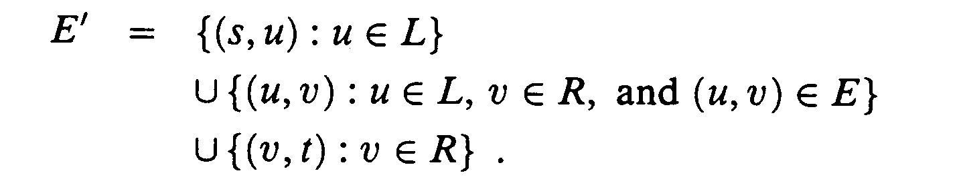
Conversion to Maximum Flow
  Have a single source s connected to each L and a single sink connected to each R
  assign a unit capacity to every edge in E’
  Flows are constrained to integer values
  The solution to the maximum flow problem gives us a solution to the maximum bipartite matching problem

Slide 50
SEARCH ALGORITHMS
Single Source Shortest Path
Graph Matching

Slide 51
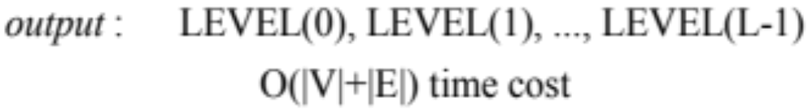
Breadth First Search Algorithm
Input: Undirected Graph G=(V,E) with root r belonging to V.
Output: LEVEL(0), LEVEL(1) …. LEVEL(L-1)

Slide 52
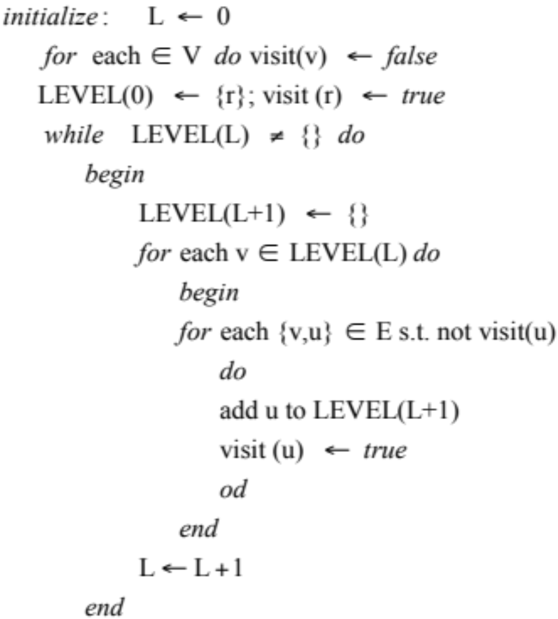
Breadth-First Search (BFS) Algorithm

Slide 53
Edmonds Karp algorithm
Input: graph (graph[v] should be the list of edges coming out of vertex v in the original graph and their corresponding constructed reverse edges which are used for push-back flow.
Each edge should have a capacity, flow, source and sink as parameters, as well as a pointer to the reverse edge.)
s (Source vertex) t (Sink vertex)
Output: flow (Value of maximum flow)

Slide 54
Edmonds Karp algorithm Contd..
flow := 0 (Initialize flow to zero)
repeat (Run a breadth-first search (bfs) to find the shortest s-t path. We use 'pred' to store the edge taken to get to each vertex, so we can recover the path afterwards)
q := queue();
q.push(s);
pred := array(graph.length);

Slide 55
Edmonds Karp algorithm Contd..
while not empty(q)
cur := q.pull();
for Edge e in graph[cur] do
if pred[e.t] = null and e.t ≠ s and e.cap > e.flow then
pred[e.t] := e;
q.push(e.t);

Slide 56
Edmonds Karp algorithm Contd..
if not (pred[t] = null) then (We found an augmenting path. See how much flow we can send) df := ∞;
for (e := pred[t]; e ≠ null; e := pred[e.s]) do
df := min(df, e.cap - e.flow)
(And update edges by that amount)

Slide 57
Edmonds Karp algorithm Contd..
for (e := pred[t]; e ≠ null; e := pred[e.s]) do
e.flow := e.flow + df;
e.rev.flow := e.rev.flow – df;
flow := flow + df ;
until pred[t] = null (i.e., until no augmenting path was found);
return flow;

Slide 58
Conclusions
Network Flow
Applications
Residual graph
Augmented Path
Ford Fulkerson Algorithm
Edmonds Karp Algorithm
Graph Matching

Slide 59
Thank You
Queries?

